Slide 1
League of Legends
By Joshua Terriquez and Sunita Thao

Slide 2
System Description
User will be able to visualize the data
User will be able to extract statistics of existing data (By doing so, they’ll be able to compare data like one champion to another.)
User will be able to add data
User will be able to remove data
User will be able to update information on existing data (abilities, in-game characters,stats)

Slide 3
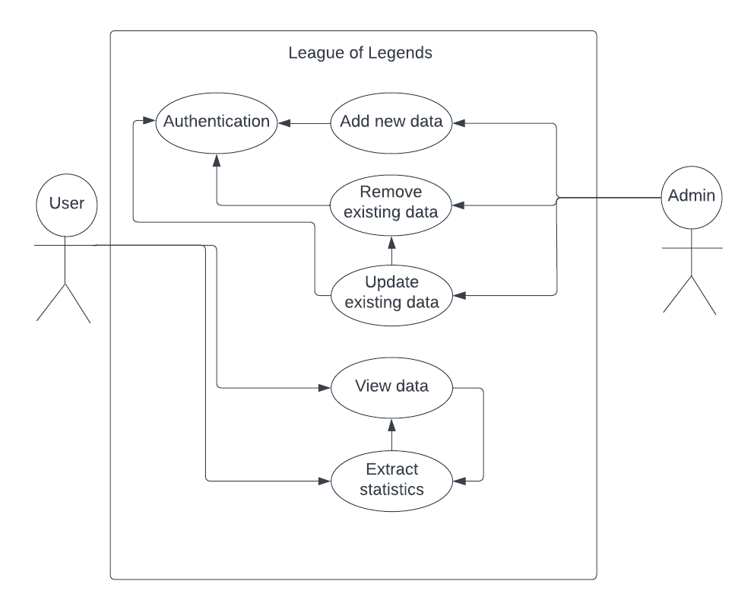
Use-Case Diagram

Slide 4
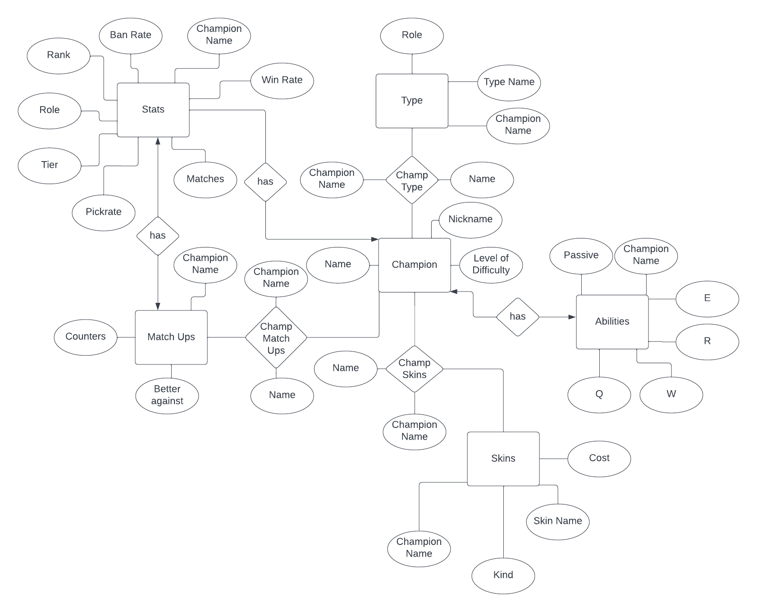
E/R Diagram

Slide 5
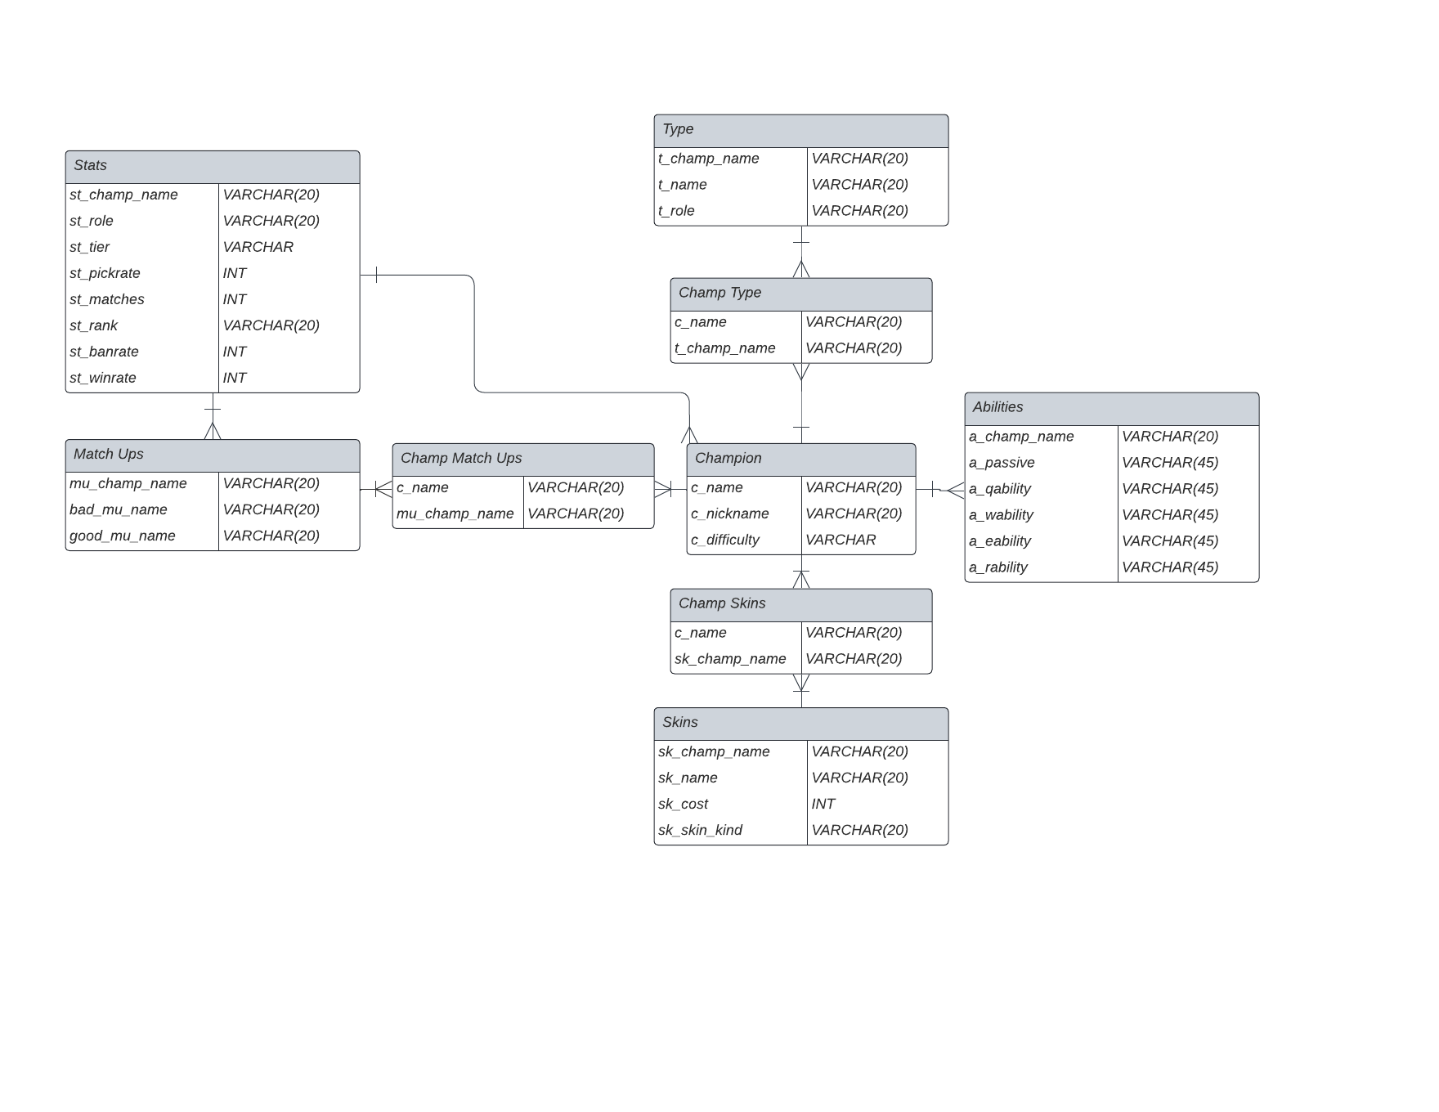
Relational Schema

